Slide 1








Object Detection
 | Result | Output Level | Instant Detect | All Areas Output | Models
Image Classification |  | Image | ✖ | 〇 | VGG ResNet Inception MobileNet DenseNet
Image Classification Localization |  | Box | ✖ | ✖ | HOG BOF PASCAL VOC
Object Detection |  | Box | 〇 | ✖ | R-CNN Fast R-CNN SDD YOLO RetinaNet
Semantic Segmentation |  | Pixel | ✖ | 〇 | U-NET MULTISCALE HYBRID CNN-CRF
Instant Segmentation |  | Pixel | 〇 | ✖ | Mask R-CNN DeepMask FCIS
Panoptic Segmentation |  | Pixel | 〇 | 〇 | Panoptic Feature Pyramid Network UPSNet
Dog 98%
Dog 93%
Dog 93%
Dog 97%
https://jingwora.github.io/

Slide 2



Slide 3






















PYSPARK
SKLEARN

Slide 4









DATA PREPARATION
ARTIFICIAL
INTTELIGENCE
DATA CLEASING
WEB
SCRAPING
MACHINE
LAEARNING
MACHINE
LAEARNING
NEURAL
NETWORK
DEEP
LAEARNING

Slide 5

WWW

Slide 7



Slide 8




Slide 9
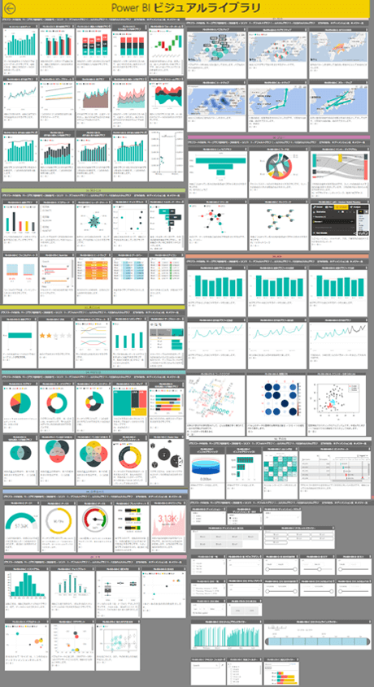
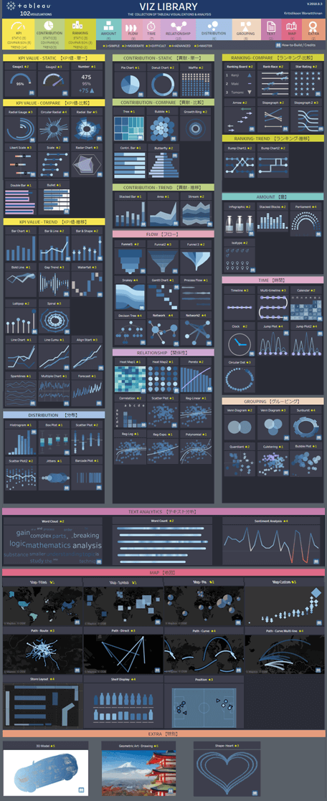
LIVE DEMO
LIVE DEMO

Slide 10





Slide 11












LIVE DEMO
CONCEPTUAL MOCKUP
ENVIRONMENT
DEV
SERVER
USER
VS CODE
Colab
Tensorflow.js
Tensorflow.js
Local + Cloud
GitHub Pages: static site
AI at the Edge

Slide 12















AI環境構築：PaaS
項目 | 内容
企業 | 電化製品 技術開発部
開発期間 | 2ヶ月 Hands-on資料
社内
管理者リソースグループ
管理者
ユーザーリソースグループ
AD認証
ネットワークセキュリティグループ
コスト リソース
MLサービスワークスペース
開発者
ストレージ
コンピューティング
レジストリ
データ
学習
モデル
AD認証

Slide 13


CONCEPTUAL MOCKUP
PaaS : AI Development Cloud Architecture
Local
Admin Resource Group
Administrator
Dev Resource Group
AD
Network Security
Cost Resource
Azure ML Service Workspace
Deployment
Developer
Bob Storage
Compute
Model Registration
Data
Training
Model
AD
https://jingwora.github.io/

Slide 14
CONCEPTUAL MOCKUP
PaaS : AI Development Cloud Resources
Local
Administrator
AD
Cost Resource
Control
Azure ML
Service
Bob
Storage
Compute
Developer
Model
Registration
Network
Security
AD
https://jingwora.github.io/

Slide 15





AI環境構築：IaaS
項目 | 内容
企業 | 電化製品 技術開発部
開発期間 | 2ヶ月 Hands-on資料
社内
リソースグループ
仮想マシン Public
仮想マシン Private
開発者
ネットワークセキュリティグループ
ネットワークセキュリティグループ
AD認証
Driver Docker
Container
Docker イメージ
Docker イメージ

Slide 16
CONCEPTUAL MOCKUP
IaaS : AI Development Cloud Architecture
Local
Resource Group
Private
VM
Public
VM
Developer
Network Security Group
Network Security Group
AD認証
Driver Docker
Container
Docker Image
Docker Image
https://jingwora.github.io/

Slide 17
CONCEPTUAL MOCKUP
IaaS : AI Development Cloud Resources
Local
Virtual
Machine
Docker
Compute
Developer
AD
Bob
Storage
Network
Security
https://jingwora.github.io/

Slide 18






AI環境構築：推論モデル・Kubernetes
項目 | 内容
企業 | 電化製品 技術開発部
開発期間 | 2ヶ月 Hands-on資料
社内
リソースグループ
MLサービスワークスペース
開発者
仮想マシン Private
Kubernetes
AD認証
ストレージ
コンピューティング
レジストリ
デプロイ
学習
モデル
Model
Web app
データ
Model
Web app
Model
Web app
ユーザー
Application Gateway
Load Balancer
AD認証

Slide 19
CONCEPTUAL MOCKUP
Kubernetes Deployment : AI Development Cloud Architecture
Local
Resource Group
ML Service
Developer
Private
VM
Kubernetes
AD認証
Blob Storage
Compute
Register
Deployment
Train
Model
Model
Web app
Data
Model
Web app
Model
Web app
User
Application Gateway
Load Balancer
AD認証
https://jingwora.github.io/

Slide 20
CONCEPTUAL MOCKUP
Kubernetes Deployment : AI Development Cloud Resources
Local
Developer
Blob Storage
AD
Azure ML
Service
Compute
Register
Application
Gateway
Network
Security
NGINX
Docker
Kubernetes
Load Balancer
Model
Web app
User
AD
https://jingwora.github.io/

Slide 21
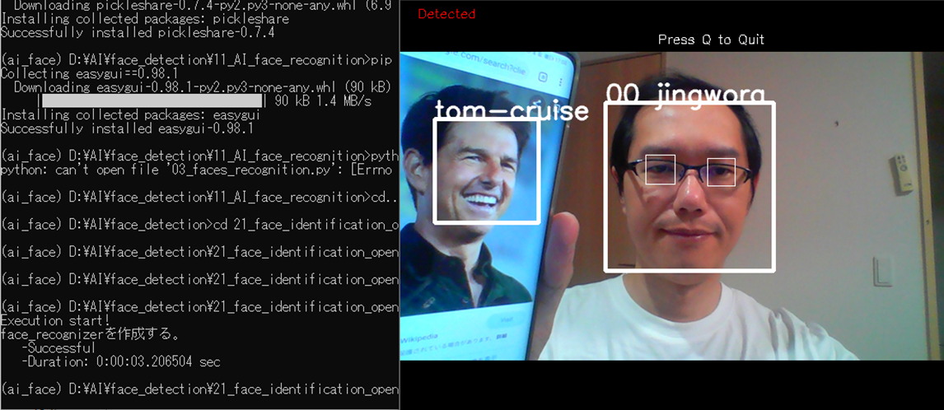




CONCEPTUAL MOCKUP
Face Recognition Framework
https://jingwora.github.io/
Train
Model
Face
Name
User
Live Camera

Slide 22
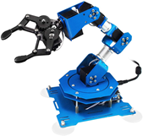

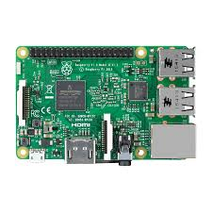
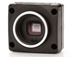
CONCEPTUAL MOCKUP
Object detection IOT
Live
https://jingwora.github.io/
Raspberry Pi
Camera
Robotic Arm

Slide 23



LIVE DEMO

Slide 24


Slide 25





Data Analyst
Data Scientist
Data Engineer
Cloud Engineer
Web Developer

Slide 26
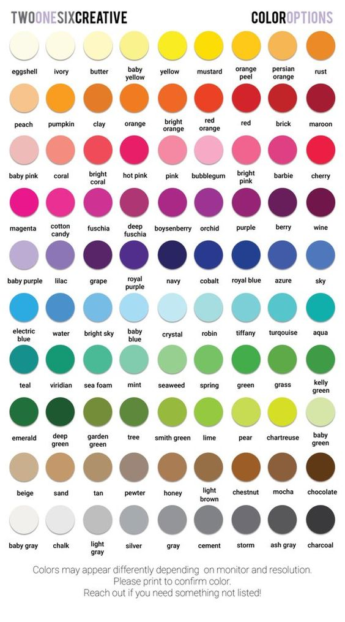
Total quality management (TQM)
4M Analysis Process
4M
 | Machine | Material | Man | Method
Plan
Actual
QA Status
 | Checking | Checked | Status | IQ
Line1
Line2
Line3
Line4
PPM
PPM
Claim
Defect

Slide 27

CONCEPTUAL MOCKUP
PRODUCTION REPORT
PRODUCTION LINE STATUS 製造ライン状況
● LIVE
COUNTRY 国 |  | REGION 地域 |  | FACTORY 工場 |  | BUILDING ビル
Japan | ▼ | Kantou | ▼ | JF001 | ▼ | B001 | ▼
OPRATION TIME 活動時間
(Actual vs Plan)
STOP TIME 停止期間
(Actual vs Plan)
BREAK TIME 休憩時間
(Actual vs Plan)
CURREN TIMELINE
現在タイムライン
(Actual vs Plan)
8,250
(85%)
350
(120%)
920
(95%)
78%
Line No. | Operation Timeline タイムライン |  |  |  |  |  |  |  |  |  |  |  |  |  |  |  |  |  |  |  |  |  |  |  | Current Status | Stop Time (minute) |  | ▲
LX101 |  |  |  |  |  |  |  |  |  |  |  |  |  |  |  |  |  |  |  |  |  |  |  |  | OP | 30 | ℹ
LD220 |  |  |  |  |  |  |  |  |  |  |  |  |  |  |  |  |  |  |  |  |  |  |  |  | BK | 0 | ℹ
LL201 |  |  |  |  |  |  |  |  |  |  |  |  |  |  |  |  |  |  |  |  |  |  |  |  | ST | 320 | ℹ
LX201 |  |  |  |  |  |  |  |  |  |  |  |  |  |  |  |  |  |  |  |  |  |  |  |  | OP | 0 | ℹ
LB301 |  |  |  |  |  |  |  |  |  |  |  |  |  |  |  |  |  |  |  |  |  |  |  |  | OP | 0 | ℹ
7:00 | 9:00 |  |  |  | 11:00 |  |  |  | 13:00 |  |  |  | 15:00 |  |  |  | 17:00 |  |  |  | 19:00 |  |  |  |  |  |  | ▼
Line: LL201
Period: 14:00 – 17:00
Controller: John Walker
Memo: Machine Repair
ℹ get Details
Operation Status: ● Stop(ST) ● Break(BK) ● Operate(OP) ● Inactive(IA)
https://jingwora.github.io/

Slide 28
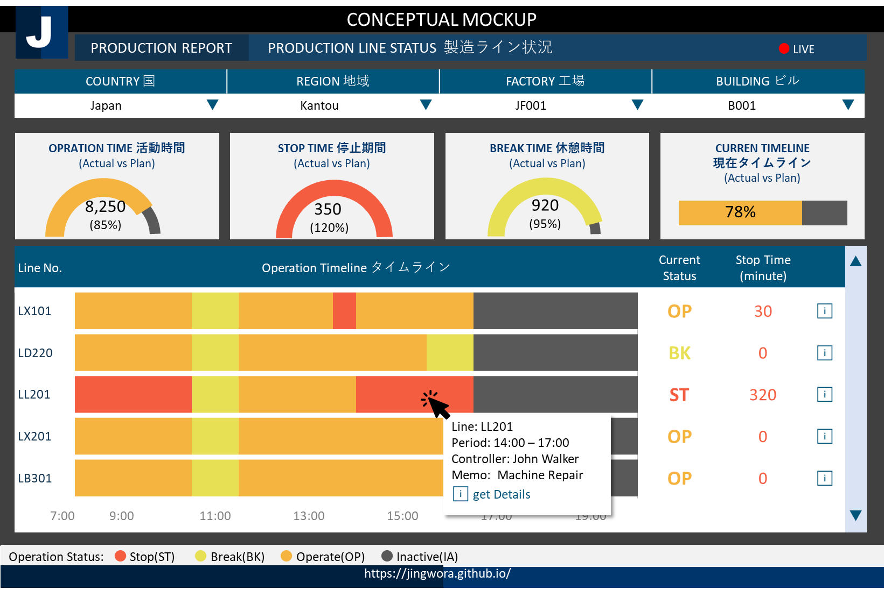





ENVIRONMENT ARCHETECTURE
DEV
OPS
USER
Data Warehouse
Ingest
SSMS
Data
Factory
SQL
Server
Power BI
Data Lake
Storage
Power BI
DAX
Language
Local + Cloud
Cloud
Visualization

Slide 29
CONCEPTUAL MOCKUP
FINANCIAL ANALYSIS REPORT 財務分析レポート
Region 地域
EU | ▼
Income Statement | Balance Sheet | Cash Flow | Financial Ratio | Root Cause | Simulation
 | 2018 |  | 2019 |  | 2020 YTD
 | Actual | Vs Budget | Actual | Vs Budget | Actual | Vs Budget
⊞ Net product sales | 79,000 | +200 | 82,000 | +200 | 101,000 | +200
⊞ Net service sales | 27,000 | -100 | 31,000 | -100 | 27,000 | -100
Total net sales | 96,000 | +100 | 113,000 | +100 | 127,000 | +100
⊟ Operating expense
Cost of sales | 71,000 | +400 | 61,000 | +400 | 81,000 | +400
Fulfillment | 13,000 | -200 | 15,000 | -200 | 19,000 | -200
Marketing | 5,000 | +300 | 4,000 | +300 | 4,000 | +300
Other operating expense | 500 | +10 | 600 | +10 | 500 | +10
Total operating expense | 88,500 | +400 | 78,500 | +400 | 94,500 | +400
⊞ Operating income | 2,500 | +200 | 3,500 | +200 | 4,400 | +200
⊞ Interest expense | (150) | -10 | (150) | -10 | (200) | -10
⊞ Other income | 100 | +50 | 100 | +50 | 100 | +50
Income before income taxes | 2,450 | +60 | 3,650 | +60 | 3,450 | +60
Provision for income taxes | (450) | -20 | (550) | -20 | (500) | -20
Net income | 2,000 | +50 | 3,100 | +50 | 2,800 | +50
Country 国
Germany | ▼
Branch 支店
Munich G01 | ▼
Fiscal Year 年度
FY2020 | ▼
Year | Quarter
EN | 日本 | 中国
Unit 単位
Million | ▼
Drill-Through
to get
more insights
ℹ get Details
Drill Down
Currency 通貨
Yen | ▼
https://jingwora.github.io/

Slide 30
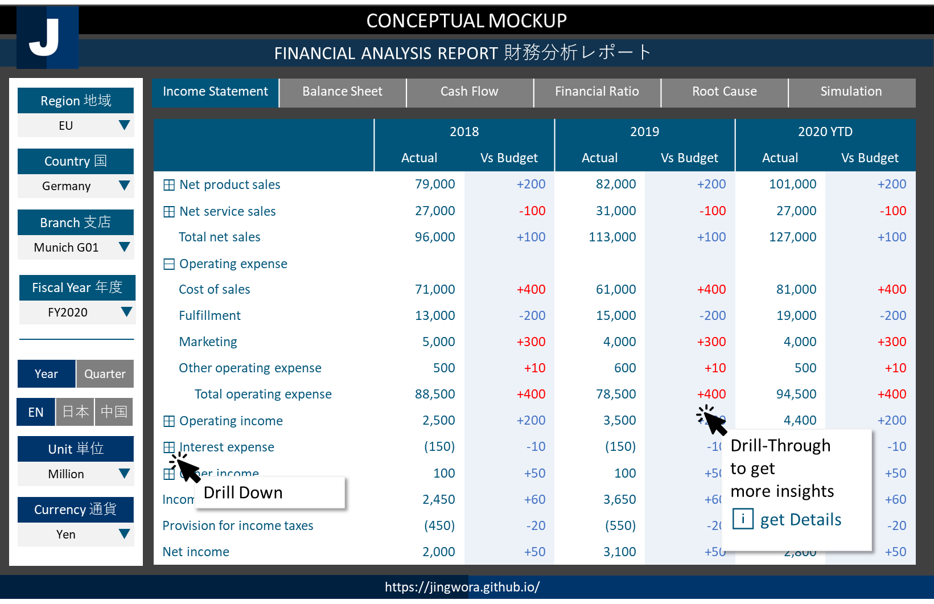

ENVIRONMENT ARCHETECTURE
DEV
OPS
USER
Data Warehouse
Ingest
SSMS
Data
Factory
SSAS
SQL
Server
Power BI
Data Lake
Storage
Power BI
DAX
Language
Local + Cloud
Cloud
Visualization

Slide 31
CONCEPTUAL MOCKUP
CUSTOMER TRANSACTION ANALYSIS 顧客のトランザクション分析
Period 期間
2020 | ▼
RFM | Sales Decomposition | Market Basket | Churn Analysis | Promotion Effectiveness | Customer Journey
RFM (No. of members) (vs LY)
 |  |  | ◀ | R1 | R2 | R3 | R4 | ▶
 | ▲
 | F4 |  | 15 +1 | 1,100 +10 | 500 -20 | 250 +20 | 12 +5
 | F3 |  | 110 -10 | 350 -10 | 320 +15 | 250 +5 | 41 +20
 | F2 |  | 207 +15 | 750 -100 | 550 +30 | 221 +15 | 315 +10
 | F1 |  | 310 -55 | 210 -20 | 130 -10 | 114 -10 | 312 -10
 | ▼
■ Platinum ■ Gold ■ Silver ■ Bronze ■ Churn
Profiles プロフィール
Area アリア
Kantou | ▼
Age
Male
38%
Branch 支店
Munich G01 | ▼
70%
60%
50%
30%
Female
62%
20’s 30’s 40’s 50’s
Recency 最終購入日
R1 | R2 | R3 | R4
1 | 2 | 3 | 4
Behavior 行動 (Product Contribution)
Frequency
Editable
Product1
Product2
Frequency 購入回数
F1 | F2 | F3 | F4
2 | 4 | 6 | 8
Product3
Get full list
For target marketing
ℹ get Details
Product4
Monetary 購入金額
M1 | M2 | M3 | M4
30 | 40 | 50 | 60
Value
https://jingwora.github.io/

Slide 32
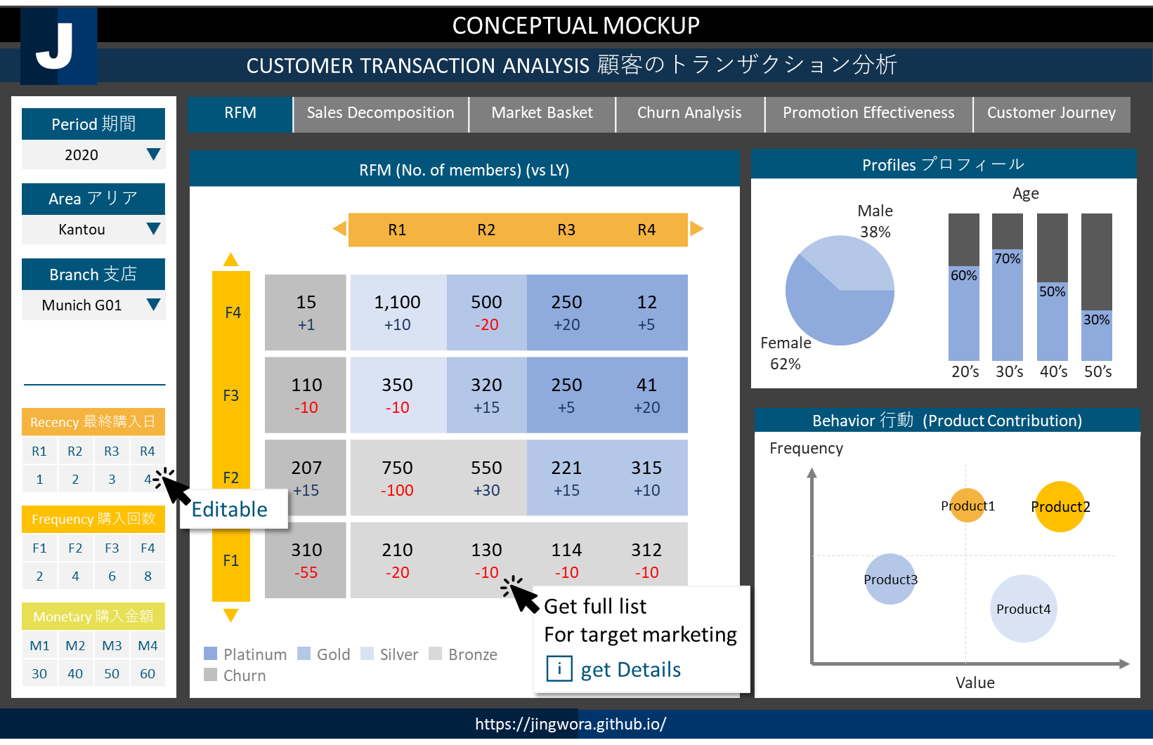
ENVIRONMENT ARCHETECTURE
DEV
OPS
USER
Data Warehouse
Ingest
SSMS
Data
Factory
SSAS
SQL
Server
Power BI
Data Lake
Storage
Power BI
DAX
Language
Local + Cloud
Cloud
Visualization

Slide 33
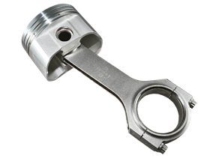
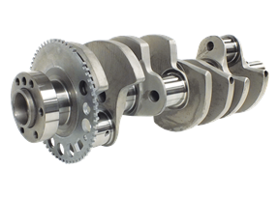
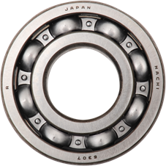
CONCEPTUAL MOCKUP
Material Management - Bill of Material (BOM)
Factory 工場
Factory 1 | ▼
BOM | Inventory Management | Order Status Analysis | Production Planning | Supply Chain Management | Cost Structure Simulation
Part No. | Description | Type | Quantity | Cost | Status | ▲
⊟ EN-101 | Assembly 1 | Assembly | 1 | 105 | Active
PX-101 | Parts 1 | Parts | 2 | 5 | Active
PX-102 | Parts 2 | Parts | 1 | 5 | Active
PX-103 | Parts 3 | Parts | 1 | 80 | Active
⊟ EN-102 | Assembly 2 | Assembly | 1 | 55 | Active
PX-104 | Pats 5 | Pats | 1 | 25 | Active
PX-105 | Parts 6 | Parts | 3 | 10 | Active
⊟ EN-103 | Assembly 2 | Assembly | 1 | 35 | Active
PX-106 | Parts 8 | Parts | 1 | 10 | Active
PX-107 | Parts 9 | Parts | 1 | 1 | Active | ▼
Detail Part No. EN-101
Department 部門
Department 1 | ▼
Catalog No. カタログNo.
ALL | ▼
Part No. パーツNo.
ALL | ▼
Description Gear Set EX | ▲
Dimension: 30*280*30
Weight: 1.5kg
Manufacturer: Manu1
Lead time: 15 days
 | ▼
BOM Structure
⊟ Product Group 1 | ▲
⊟ Product 1
■ Assembly 1
■ Assembly 2
□ Assembly 3
□ Assembly 4
□ Assembly 5
⊞ Product 2
⊞ Product 3
⊞ Product Group 2 | ▼
PX-101
PX-102
PX-103
EN-101
FXN-501
https://jingwora.github.io/

Slide 34
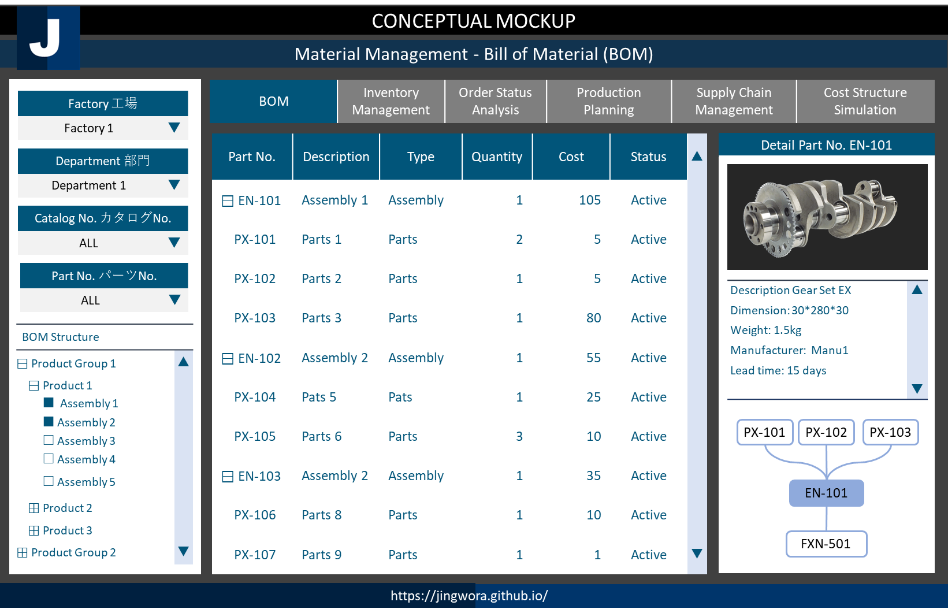
ENVIRONMENT ARCHETECTURE
DEV
OPS
USER
SQL
Workbench
Tableau
My SQL DB
Tableau
Local
On-prem
Visualization

Slide 35






CONCEPTUAL MOCKUP
Logistic Map Analysis 1
◀ | Logistic Map | World Map Inventory Status | Detail Report | ▶
Regions
Region 1 | ▼
Product Groups
ALL | ▼
Factory
Warehouse
Shipment
Store warehouse
Store
Inventory: 5,341
Stock day: 15
NORMAL
Inventory: 8,142
Stock day: 21
NORMAL
Inventory: 8,531
Stock day: 25
NORMAL
Inventory: 4,780
Stock day: 37
HIGH
Inventory: 1,337
Stock day: 11
LOW
Trend
Trend
Trend
Trend
Trend
Stock Day Level：■ Normal Level ■ Warning Low Level ■ Warning High Level
https://jingwora.github.io/

Slide 36
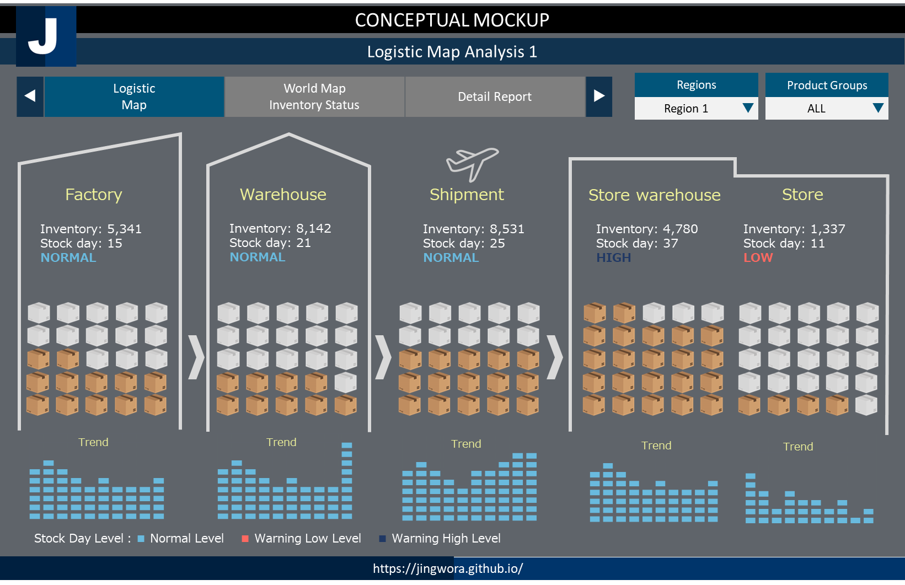
ENVIRONMENT ARCHETECTURE
DEV
OPS
USER
SQL
Workbench
Tableau
My SQL DB
Tableau
Local
On-prem
Visualization

Slide 37
CONCEPTUAL MOCKUP
INVENTORY MANAGEMENT 在庫管理
Region 地域
EU | ▼
Inventory Simulation | Inventory Cost Analysis | Stock turn Analysis | Supply chain Magement | PSI Report
Opportunity Loss Ranking 機会損失ランク
PSI
Country 国
Germany | ▼
Rank | Product ID | Product Name | Opportunity Loss | ▲
1 | 1011 | Product A
2 | 1020 | Product B
3 | 1001 | Product C
4 | 1002 | Product D
5 | 1201 | Product E
6 | 1355 | Product F
7 | 1702 | Product G
8 | 1822 | Product H
9 | 1677 | Product I
10 | 1022 | Product J |  | ▼
Unit
Department
ALL | ▼
2020 01 2020 02 2020 03 2020 04 2020 05 2020 06
Product 製品
ALL | ▼
● P (Production) ● S (Sales) ● I (Inventory)
Simulation シムレイション
Period 期間
2020 | ▼
Unit
2020 01 2020 02 2020 03 2020 04 2020 05 2020 06
Optimizer | 50 | 30 | 20 | 20
Fine-tuner | 0 | 0 | 50 | 50
Optimizer1 | ▼
● Production ● Auto-filled ● Adjusted Parameter
UPDATE
https://jingwora.github.io/

Slide 38
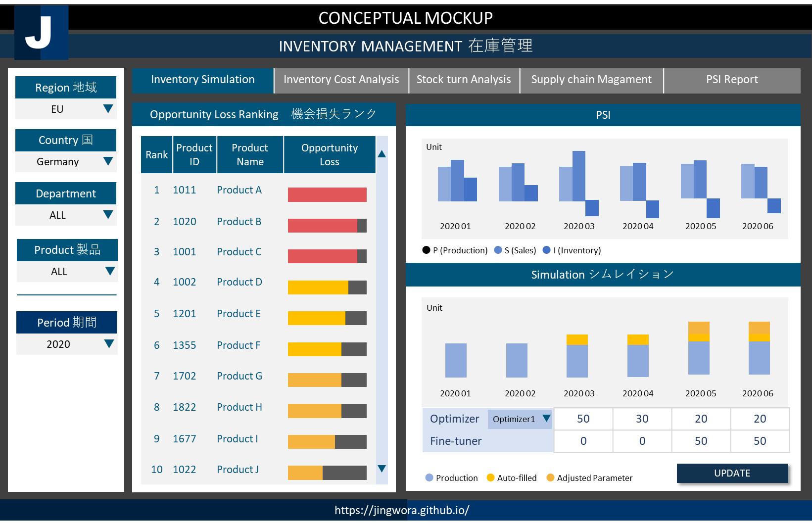




ソリューション：
売り上げ予測により製造・在庫の最適化
業務フローの最適化によるコストの削減
商品の組み合わせ変更による売り上げと利益の最大化
お客様情報：電子機械メーカー
Solutions:
Develop sales predictive model and inventory optimization model
Decrease operating cost by optimize process flow.
Identify the right product mix that optimize sales and profit.
Client: Electronic Machine Maker
ENVIRONMENT ARCHETECTURE
DEV
OPS
USER
Data Warehouse
Ingest
SSMS
Power BI
Data
Factory
SQL
Server
Power BI
Data Lake
Data Lake
Storage
Spark
Databricks
Power
App
PySpark
Azure
DevOps
Bronze | Silver | Gold
Local + Cloud
Cloud
Visualization

Slide 39
CONCEPTUAL MOCKUP
Demand Pattern Analysis 需要パターン解析
Country 国
Germany | ▼
Demand Overview 需要ダッシュボード | Seasonality & Trends 季節性・トレンド | Outliner 異常値 | Model Expandability 説明性 | …
Opportunity Loss Ranking 機会損失ランク
Department
ALL | ▼
Product Detail |  |  | Seasonal |  |  | Trend |  |  | Outliner |  | ▲
Rank | Product ID | Product Name | Seasonal Test | High Season | High Season Index | Trend Test | Slope | Change Points | Predicted Sales | Model Error (MAPE)
1 | 1011 | Product A | 1 | Mar | 121 | 1 | 10 | OCT-2020 | 15,000 | +/- 2%
2 | 1020 | Product B | 0 | Feb | 102 | 0 | 2 | - | 2,500 | +/- 10%
3 | 1001 | Product C | 1 | Dec | 110 | 1 | -5 | NOV-2020 | 7,950 | +/- 4%
… | … | … | … | … | … | … | … | … | … | … | ▼
Product 製品
ALL | ▼
Period 期間
2020 | ▼
Seasonal Index
Trends
Outliner
JAN | FEB | MAR | APR | MAY | JUN | JUL | AUG | SEP | OCT | NOV | DEC
●
Periods
● Actual ● Trend ● Change Point
Periods
● Actual ● Outliner
● Seasonal Index
https://jingwora.github.io/

Slide 40








ENVIRONMENT ARCHETECTURE
 | 1. Environment Preparation | 2. Raw Data Processing | 3. Standard Data Processing | 4. AutoML | 5. Reports
Process | Prepare development resources. | Load raw data and create standard data. | Autocorrelation, Statical test and Trend data processing | AutoML forecasting (1,000 models in 20 mins) | Create report
Resources | - DevOps - Azure Data Factory - Azure SQL Server - Spark Databricks - Blob Storages - Azure ML Service | Blob Storages Data factory Spark Databricks Azure SQL Server | Data factory Spark Databricks Azure SQL Server | Azure ML Service - Azure Compute Instant - Azure Compute Cluster - Azure App Service | Power BI Azure SQL Server
Input | - ARM Template - SQL .sln (DDL) - Git resource | CSV: - Sales - Product - Calendar | Database: - Sales - Product | Database: - Sales | Databases:
Output | All required environments | Delta Lake & Database: - Sales - Product - Calendar | Delta Lake & Database: - Autocorr - Stat test - Trend | Delta Lake & Database: - Sales Forecast - Sales Forecast Metrics | Power BI reports:
Development Tools
Codes
Data
Factory
Spark
Databricks
AML
SQL
Server
Power BI
Data Lake
Azure
DevOps
Git
SSMS
SQL
Python
PySpark
Raw
Data
(CSV)
Processed
Data
Statistics
AutoML
Database
Reports
Azure
App Service

Slide 41
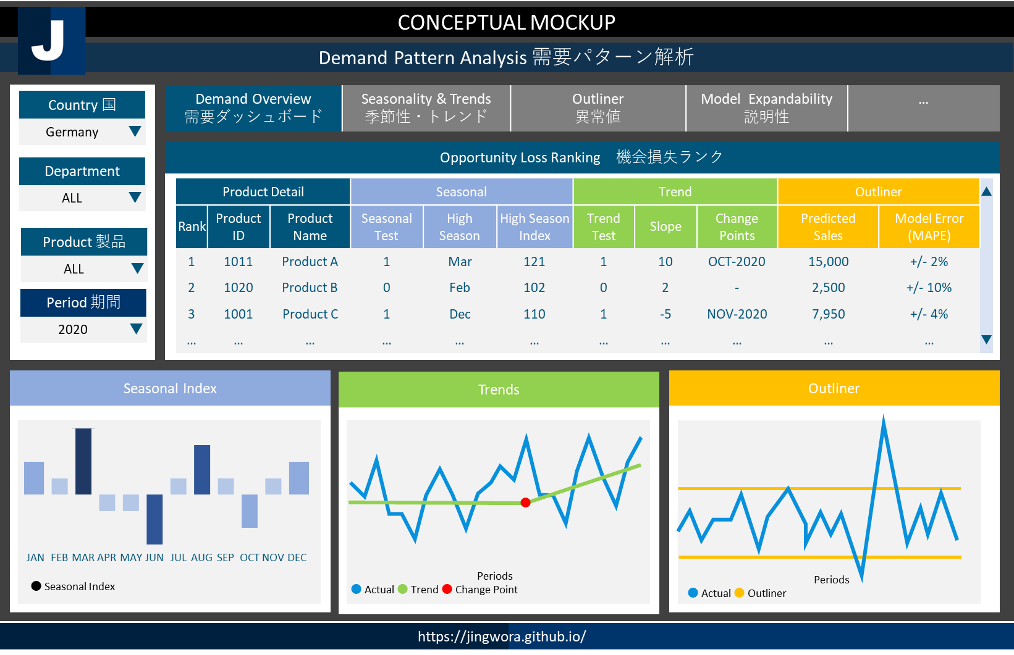

季節のパターンの理解に基づいて製造、販売の計画を最適化する
購買履歴、顧客属性に合わせて商品推奨で顧客育成、利益効率を高める、
消費者のニーズに合わせて新製品の機会と需要の発見
お客様情報：電子機械メーカー
Understand seasonal pattern to optimize production and sales plan.
Provide recommended product to optimize profit based on buying behavior and characteristic.
Understand customer need and find out new opportunity.
Client: Electronic Machine Maker
ENVIRONMENT ARCHETECTURE
DEV
OPS
USER
Data Warehouse
Ingest
SSMS
Data
Factory
SQL
Server
Power BI
PySpark
Data Lake
Data Lake
Storage
Spark
Databricks
Azure
DevOps
Bronze | Silver | Gold
Power BI
Local + Cloud
Cloud
Visualization

Slide 42

CONCEPTUAL MOCKUP
SENTIMENT：CUSTOMER JOURNEY センチメン・カスタマージャーニー
Sentiment 感情分析 | Drill-through ドリルスルー | Sentiment Trend 感情トレンド | By Area エリア別の分析 | By Product 製品別の分析 | Detail 詳細
Awareness
認知
Research
比較検討
Purchase
購入
Experience
顧客体験
Negative Rate
Negative Rate
Negative Rate
Negative Rate
15%
30%
10%
32%
Topics | Sentiments
Topic1
Topic2
Topic3
Topic4
Topic5
Topic6
Topic7
Topic8
Topics | Sentiments
Topic1
Topic2
Topic3
Topic4
Topic5
Topic6
Topic7
Topic8
Topics | Sentiments
Topic1
Topic2
Topic3
Topic4
Topic5
Topic6
Topic7
Topic8
Topics | Sentiments
Topic1
Topic2
Topic3
Topic4
Topic5
Topic6
Topic7
Topic8
Sentiment ：■ Positive ■ Neutral ■ Negative
https://jingwora.github.io/

Slide 43




ENVIRONMENT ARCHETECTURE
 | 1. Environment Preparation | 2. Data Processing | 3. Sentiment Analysis | 4. Reports
Process | Prepare development resources. | Load raw data and process data. | Keywords and sentiment processing | Create report
Resources | - Azure Data Factory - Azure SQL Server - Blob Storages - Azure Cognitive Service | Blob Storages Data factory Azure SQL Server | Azure cognitive service Data factory Azure SQL Server | Power BI Azure SQL Server
Input | - ARM Template - SQL .sln (DDL) | CSV: - phone - chatbot - email | Database: - Message - Category | Databases:
Output | All required environments | Database: - Message - Category - Calendar | Database: - Keywords - Sentiment | Power BI reports:
Data
Factory
Azure Text
Analytics API
SQL
Server
Power BI
CS phone
script
chatbot
email
Data Lake Storage
Raw
Data
(CSV)
Raw
Data
(CSV)
Raw
Data
(CSV)
Processed
Data
(CSV)
Sentiment
Database
Reports

Slide 44
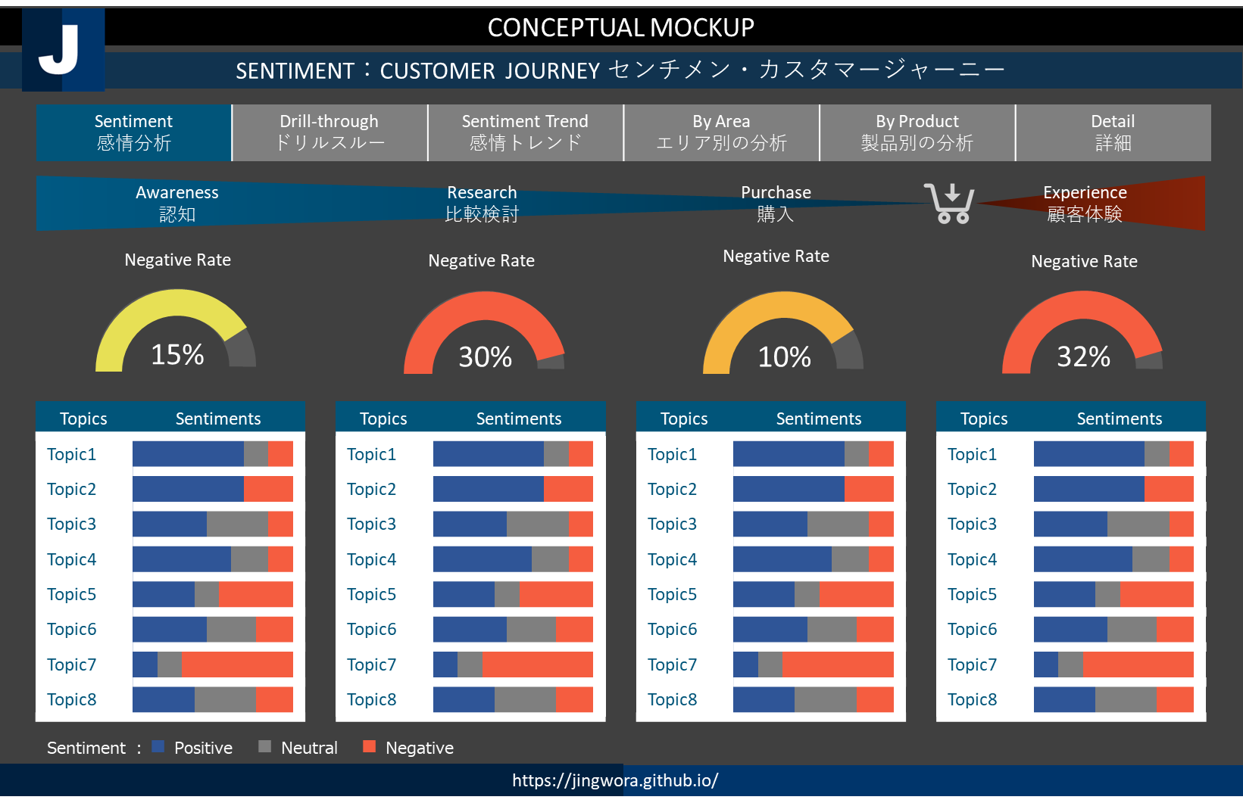
業務フローの最適化によるコストの削減
商品の組み合わせ変更による売り上げの最大化
売り上げ予測により製造・在庫の最適化
新製品の機会と需要の発見
購買履歴、顧客属性に合わせて商品推奨で顧客育成、利益効率を高める
消費者のニーズに合わせて、
DATAFLOW ARCHETECTURE
CS phone
script
chatbot
email
Data Lake
Storage
Data
Factory
Azure Text
Analytics API
SQL
Server
Power BI
Raw
Data
(CSV)
Raw
Data
(CSV)
Raw
Data
(CSV)
Processed
Data
(CSV)
Sentiment
Database
Reports

Slide 45
CONCEPTUAL MOCKUP
STUDENT PERFORMANCE ANALYSIS 成績評価分析
Performance Analysis 成績評価分析 | Comparison Report 比較レポート | Course Analysis 科目分析 | ML Clustering クラスター分析 | ML Forecast 予測分析 | ▶
Year 年度
2020 | ▼
KPI1
KPI2
KPI3
KPI4
Semester 学期
秋学期 | ▼
School Info 学校情報
Class Info 科目情報
Trends 傾向
Correlation 相関係数
Student Info 学生情報
2020 S1 | 2020 S2 | 2021 S1 | 2021 S2 | 2022 S1 | 2022 S2 | 2023 S1 | 2023 S2
F
a
c
t
o
r
1
Questionnaire 調査情報
Periods
● KPI
Factor2
● Group A ● Group B
https://jingwora.github.io/

Slide 46
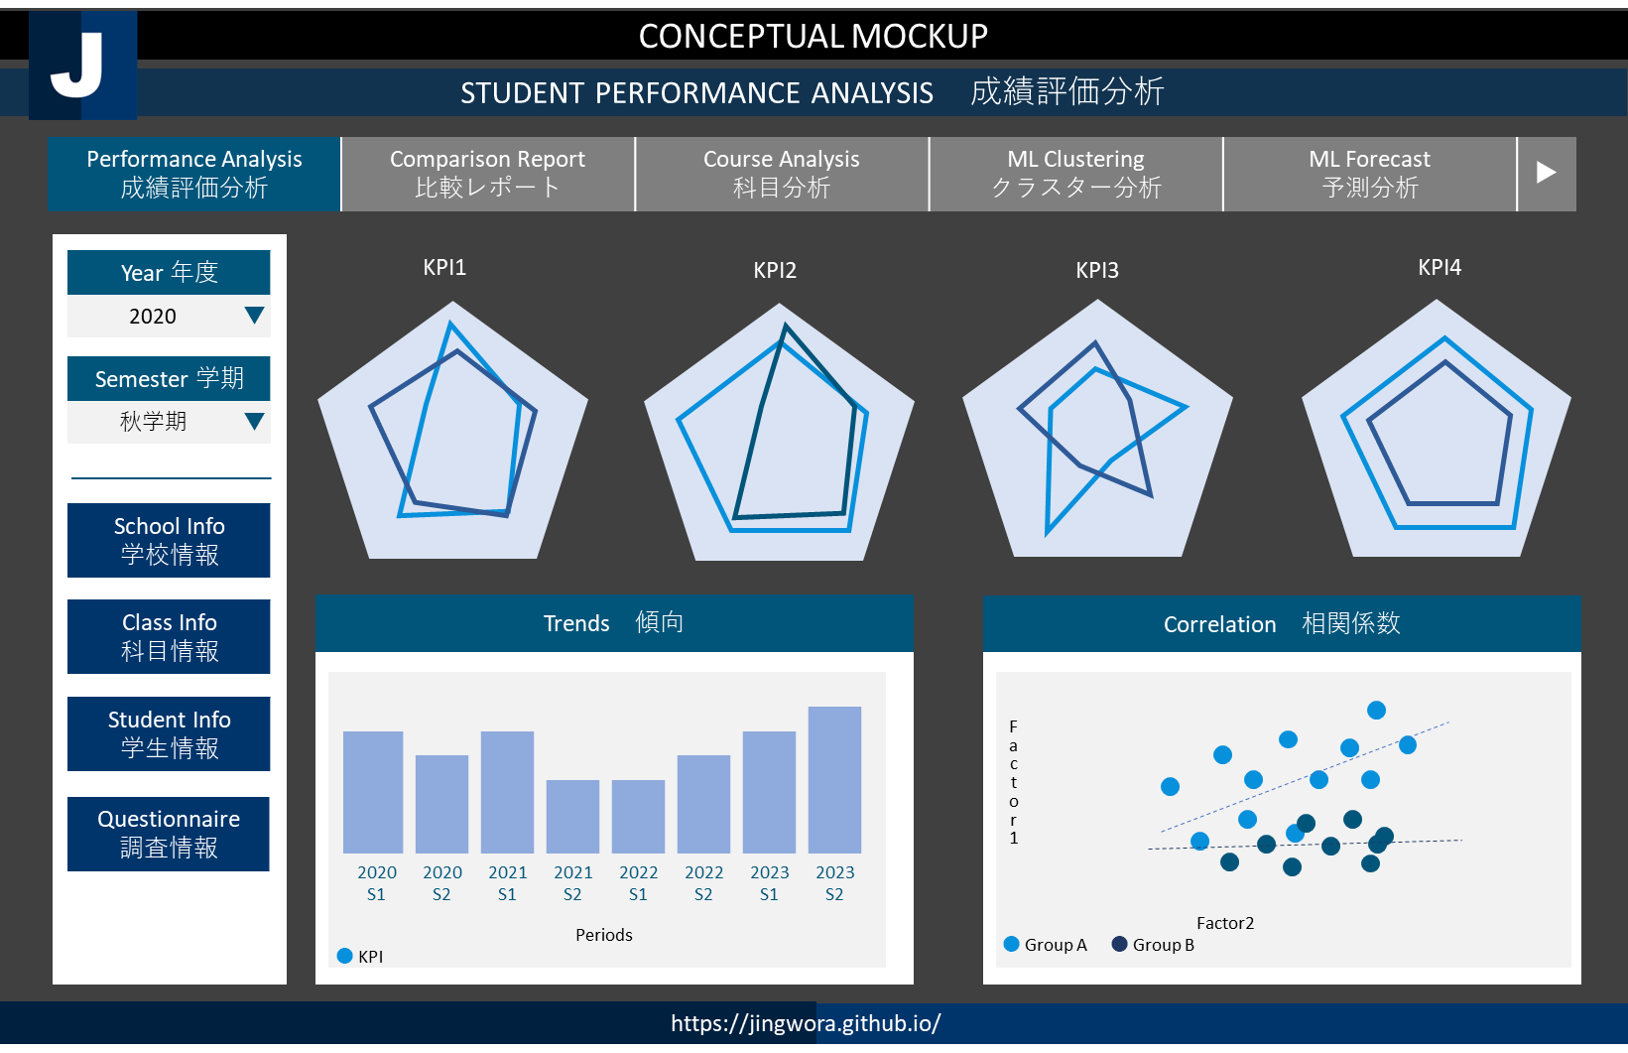



ソリューション：
・学生・教員評価のシステム化に基づいて 、PDCA改善のサイクルがスムーズに移行し、早める
・人人の学生の成績、個性、 特色に応じて指導・学習支援の最適化
・採用ニーズの変化に合わせてカリキュラムを提供する学習支援する
お客様情報：日本の一流大学
Solutions:
・Improve and speed up PDCA cycle by preparing faculty and student evaluation system.
・Understand student performance, characteristics and needs to provide best learning support.
・Provide most suitable curriculum that meets changing job market.
Client: Leading University in Japan
ENVIRONMENT ARCHETECTURE
DEV
OPS
USER
Ingest
AI
Data Lake
Storage
Synapse
Analytics
Azure
AutoML
Power BI
Git
Bronze | Silver | Gold
Power BI
Desktop
Local + Cloud
Cloud
Visualization

Slide 47
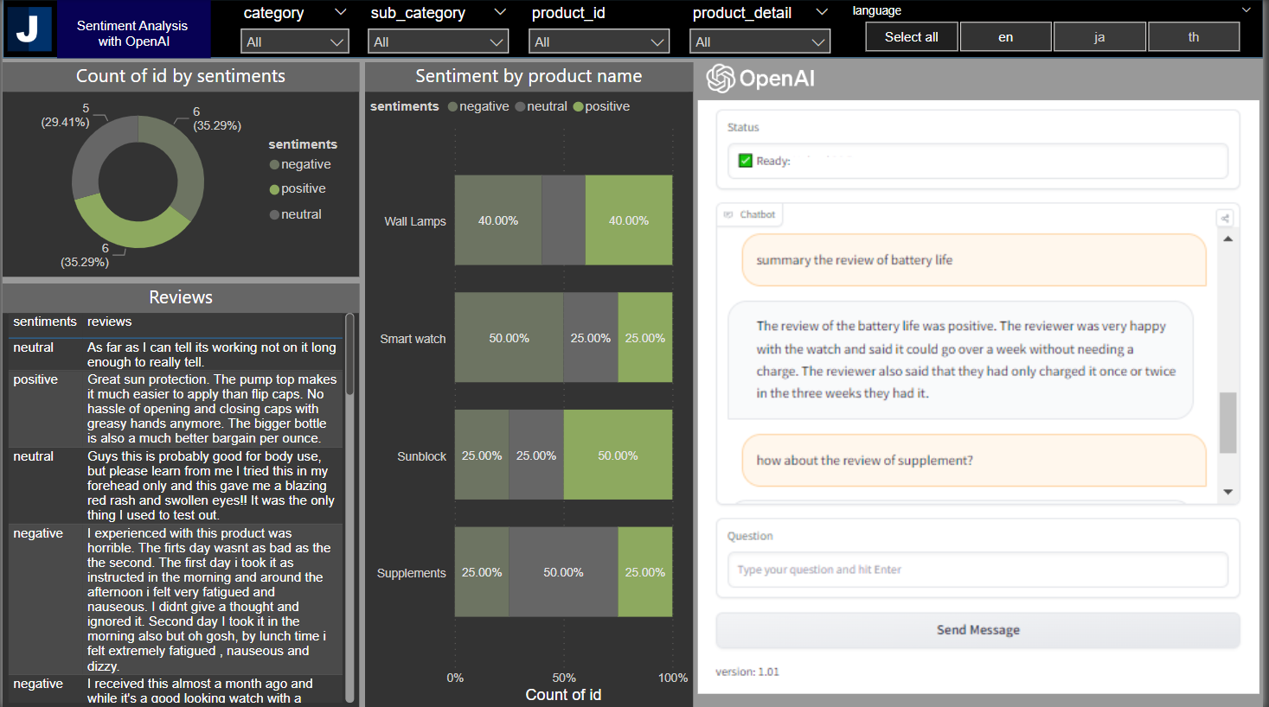







Power BI + OpenAI

Slide 49
CONCEPTUAL MOCKUP [Real report is much more complex]
PERFORMANCE REPORT 業績レポート
Region 地域
Kanto | ▼
Performance | Sales | Material | Man | Expense | Management
 | 2022 |  | 2023 |  | 2020 YTD
 | Actual | Vs Budget | Actual | Vs Budget | Actual | Vs Budget
⊞ Sales | 79,000 | +200 | 82,000 | +200 | 101,000 | +200
Product A | 7,000 | -100 | 1,000 | -100 | 7,000 | -100
Product B | 6,000 | +100 | 3,000 | +10 | 4,000 | +100
Product C | 5,000 | +10 | 3,000 | +100 | 2,000 | +100
⊞ Cost | 27,000 | -100 | 31,000 | -100 | 27,000 | -100
Profit | 96,000 | +100 | 113,000 | +100 | 127,000 | +100
Store 拠点
S1001 | ▼
Category 分類
S1001 | ▼
Fiscal Year 年度
FY2020 | ▼
Profit
Cost
Year | Quarter
Role Level Security
JAN | FEB | MAR | APR | MAY | JUN | JUL | AUG | SEP | OCT | NOV | DEC
User 1
user1@example.com
Role: Area Manager
Periods
● Actual ● Budget
● Profit
https://jingwora.github.io/

Slide 50
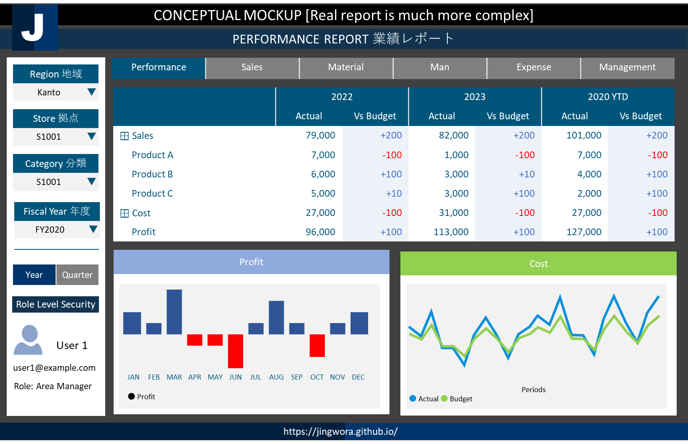
ENVIRONMENT ARCHETECTURE
DEV
OPS
USER
Ingest
Data Lake
Storage
Synapse
Analytics
Power BI
Power BI
Desktop
Bronze | Silver | Gold
Local + Cloud
Cloud
Visualization

Slide 51
CONCEPTUAL MOCKUP
APP ANALYTICS REPORT アプリ分析レポート
App アプリ
EU | ▼
App Performance Analysis アプリパフォーマンス分析 | Funnel Analysis ファネル分析 | Channel Analysis チャンネル分析 | Monetize Analysis 収益化分析 | ▶
Country 国
Germany | ▼
Department
ALL | ▼
Product 製品
ALL | ▼
Period 期間
2020 | ▼
https://jingwora.github.io/

Slide 52

機械学習改善のガイド
時系列データ
改善サイクル
データ準備
データ
期間
社内
外部データ
ビジネス
理解
データ
準備
・粒度
・ 日、月、年、…
・祝日
・稼働日
・価格、キャンペーン
・イベント
・製品の属性
・拠点の属性
・気象データ
・
モデル改善
サイクル
・目標
・メトリクス
・期間
・環境
特徴作成
モデル
評価
特徴
作成
欠損値処理
製品フィルター
特徴量エンジニアリング
・削除
・欠損値
・新製品
・データ少ない
・平均、合計、標準偏差
・ Lag
運用
モデル
作成
モデル作成
・デプロイ
・可視化
・モニタリング
単変量モデル
多変量モデル
・MA, EMA、ARIMA、SARIMA
・ETS
・Prophet、ThymeBoost
…
・Linear regression、LASSO、 Ridge、Elastic Net
・Decision Tree、GBM、LGBM、AdaBoost、CatBoost
・FN、RNN、LSTM、CNN、GRU、N-BEATS
・AutoML
…
ベストプラクティス
・全体データの予測結果より、拠点別合計の予測結果の方がよい。
・複数モデルを組み合わせるアンサンブルモデルはよりも精度が高くなる。
・モデル精度と運用性のバランスが必要。
モデル評価
メトリクス
交差検証
・RMSE、WMAPE
・時系列交差検証
https://jingwora.github.io/
https://www.kaggle.com/competitions/rossmann-store-sales
https://www.kaggle.com/competitions/favorita-grocery-sales-forecasting
https://www.kaggle.com/competitions/m5-forecasting-accuracy

Slide 53
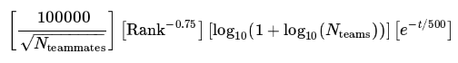
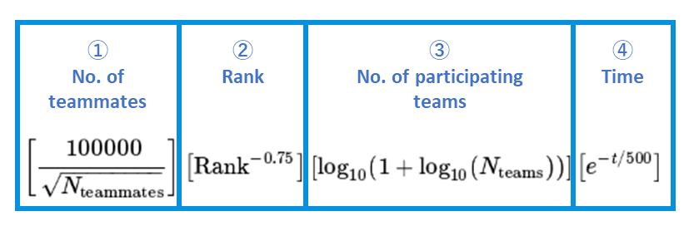
①
No. of teammates
②
Rank
③
No. of participating teams
④
Time

Slide 54
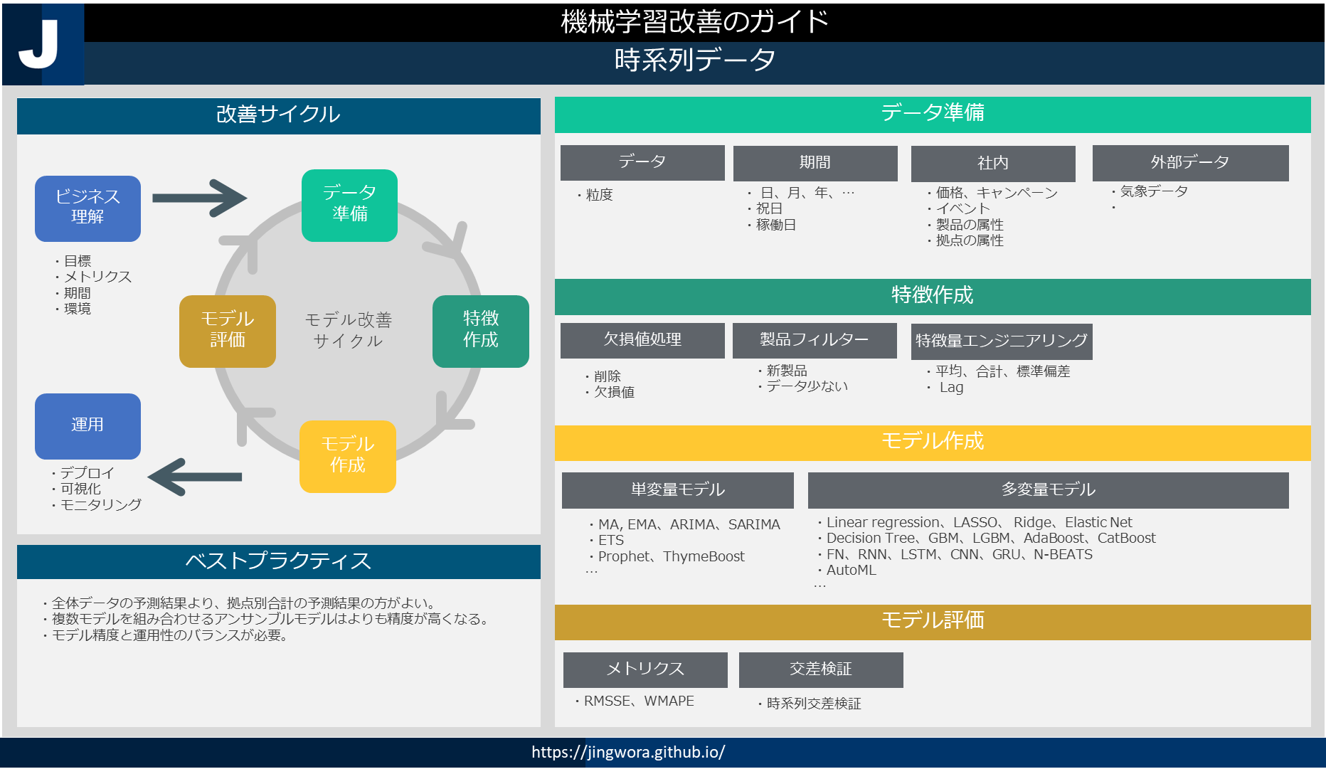
ソリューション：
売上予測モデル改善サイクル
・ 大規模な機械学習のエンド ツー エンドのハンズオン トレーニング (ETL、データ クリーニング、特徴量エンジニアリング、モデル実験、モデル評価、モデル改善、レポート)
・低コスト・安全な機械学習開発環境
・予測モデル改善サイクルの高速化
お客様情報：農機具メーカー
Sales Forecast Improvement Cycle
Solutions:
・ Large-scale Machine Learning end-to-end hand-on training (ETL, data cleaning, feature engineering, model experiment, model evaluation, model improvement, report)
・Low cost and Secured Machine Learning Development Environment
・Fast improving iteration process
Client: Agriculture equipment & tools manufacturer
ENVIRONMENT ARCHETECTURE
DEV
OPS
USER
Ingest
AI
Azure ML
Compute
Instant
Synapse
Analytics
Azure ML
Compute
Instant
Power BI
Data Lake
Storage
Bronze | Silver | Gold
Power BI
Desktop
Local + Cloud
Cloud
Visualization

Slide 55
CONCEPTUAL MOCKUP
CUSTOMER RETENSION REPORT 新規顧客獲得・顧客維持レポート
Region 地域
EU | ▼
Customer Retention 顧客維持 | Churn Analysis チャーン分析 | Action Plan 行動計画 | Action Tracking
Country 国
Germany | ▼
Churn
解約
(Actual vs Plan)
CURREN TIMELINE
現在タイムライン
(Actual vs Plan)
CURREN TIMELINE
現在タイムライン
(Actual vs Plan)
Department
ALL | ▼
￥1K
￥ 2.5K
￥
Product 製品
ALL | ▼
Period 期間
2020 | ▼
https://jingwora.github.io/

Slide 56
CONCEPTUAL MOCKUP
CUSTOMER SERVICE ANALYSIS 顧客満足度分析
Customer Journey | NPS 顧客満足度
PROSPECT
PURCHASE
USE
AFTER USE
Call Center
Call Center
TV Ads
Service Center
Store
Website
APP
E-mail
Landing Page
APP
LINE
Call Center
Website
YouTube
APP
APP
Twitter
Chatbot
Facebook
https://jingwora.github.io/

Slide 57
Multi-dimension analysis
Alert
Regular Report
Transaction Analysis
Statistical Analysis
Dossier library (Microstrategy)

Slide 58
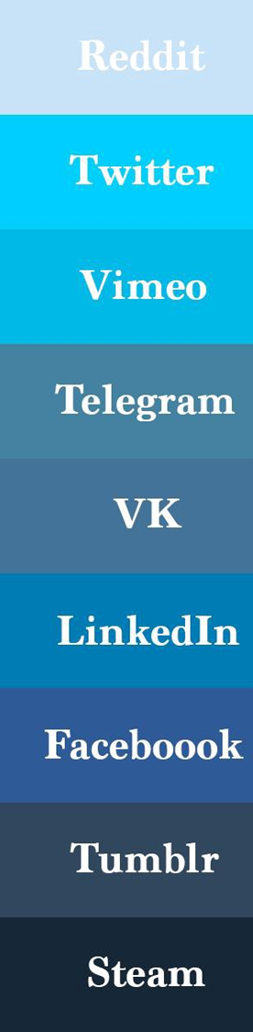







Python
Clean Code
Python
Environment
Object
Detection
Similarity &
Distance
Algorithms
TensorFlow Developer Certificate
Azure Fundamentals

Slide 59
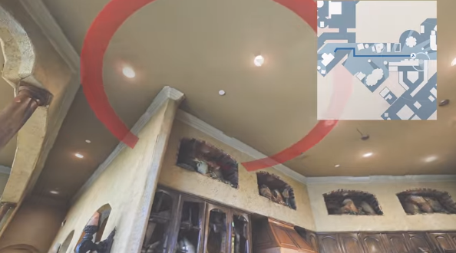





Python
Logging
Best Practices
Facebook Embodied Agent
http://gg.gg/lw5fr
Survival
Analysis
Python
Applications

Slide 60
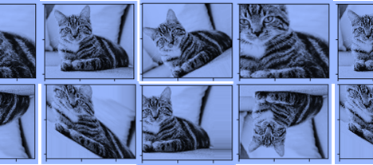








Data Augmentation
データ拡張
Feature Scaling
特徴量のスケーリング

